Slide 1

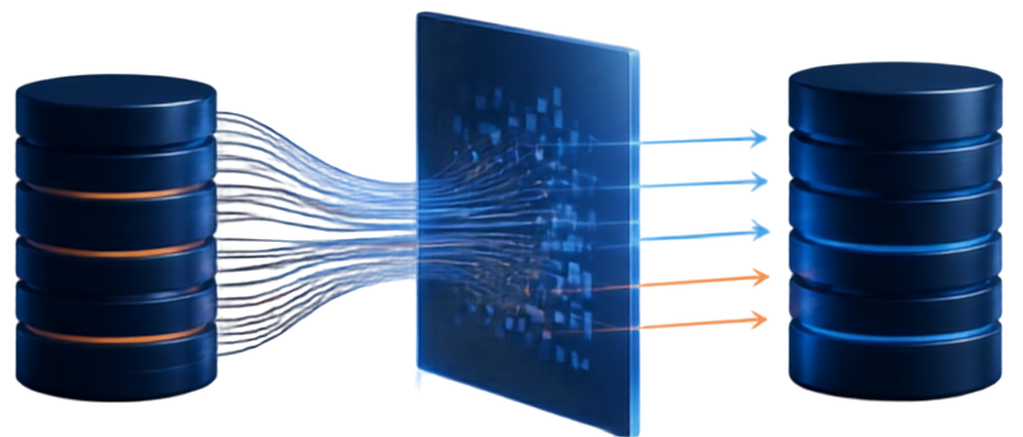



SHADAN WOMEN'S COLLEGE OF ENGINEERING AND TECHNOLOGY
[ An Autonomous Institution Affiliated to JNTUH ]
HANDLING DATABASE MIGRATION
Presented by : Amath ur Rasheed U.A
Ht. No. :24L51A0508
Class : B.tech 3rd Year 1st Semester
Section : CSE - A
Subject : DevOps

Slide 2





DATABASE MIGRATION
The process of moving data between databases while changing storage, schema, or even the database engine along the way.
WHY ORGANIZATIONS MIGRATE
Cloud modernization
and infrastructure scaling
Legacy system
deprecation
Cost optimization
and license efficiency
Performance enhancements
and latency reduction
CORE MIGRATION CAPABILITIES
Schema
Conversion
Data Extraction
& Transformation
(ETL)
Change Data Capture
(CDC)
Validation & Verification

Slide 3
CORE FUNCTIONALITIES
How migration platforms move, transform, synchronize, and validate data.
SCHEMA CONVERSION
Translates structures and definitions to the target database dialect
DATA EXTRACTION & TRANSFORMATION
Extracts, cleanses, and restructures data for accurate loading
CHANGE DATA CAPTURE
Captures and applies continuous changes to keep systems synchronized
VALIDATION & VERIFICATION
Ensures accuracy with checksum audits, row counts, and integrity tests

Slide 4

MIGRATION METHODS & STRATEGIES
Choose the approach that best balances speed, risk, and business continuity.
BIG BANG MIGRATION
PHASED / TRICKLE MIGRATION
ZERO-DOWNTIME MIGRATION
LIFT-AND-SHIFT (REHOSTING)
Single operational window
Continuous, smaller increments with CDC
Parallel source and target databases
Move to cloud infrastructure as-is
Fast and simple to execute
No downtime for end users
Dual-write replication keeps data in sync
Preserves schema, configuration, and dependencies
Higher downtime and single-point-ofFAILURE exposure
Final cutoff with minimal disruption
Greater project complexity
Fast path to the cloud with minimal change

Slide 5








MIGRATION EXECUTION LIFECYCLE
1
2
3
4
Assessment & Discovery
Planning &
Schema Design
Execution & Testing
Cutover &
Post-Migration
  Inventory data assets
  Choose infrastructure
  Run dry runs
  Re-point traffic
  Map dependencies
  Design schemas
  Perform full syncs
  Monitor real-time metrics
  Evaluate schema compatibility
  Select ETA/CDC tools
  Execute CDC incremental loads
  Decommission legacy hardware safely
  Build rollback plan
  Define performance benchmarks
  Validate data integrity

Slide 6
KEY ADVANTAGES
IMPROVED SCALABILITY
Elastic cloud storage and compute handle application workload spikes.
ENHANCED SYSTEM PERFORMANCE
Modern database architectures reduce query latency and accelerate processing.
COST EFFICIENCY
Managed database services lower licensing costs and operational overhead.
HIGH AVAILABILITY & DISASTER RECOVERY
Multi-region replication, automated backups, and higher uptime guarantees.

Slide 7

REAL-WORLD APPLICATIONS
MONOLITH TO MICROSERVICES
Separate domain databases for payments, users, and inventory.
ON-PREMISES TO CLOUD
Move SQL Server or Oracle to
AWS RDS, Azure SQL, or Google Cloud Spanner.
SQL TO SQL MIGRATION
Move unstructured or semi-structured data to MongoDB or DynamoDB.
DATABASE ENGINE CONSOLIDATION
Standardize disparate systems into open-source PostgreSQL.

Slide 8












CRITICAL CHALLENGES & MITIGATIONS
CHALLENGE
MITIGATION
Data Corruption & Loss Risk
Full backups, checksum validation,
and automated data comparison scripts
Extended System Downtime
CDC and dual-write synchronization
before final cutoff
Schema & Data Incompatibility
Conversion tools, data type
mapping matrices, and dry-run environments
Security & Regulatory Compliance
End-to-end encryption in transit and at rest,
plus strict access controls

Slide 9

CONCLUSION
Database migration is a strategic process that enables organizations to modernize infrastructure, boost performance, and achieve seamless scalability. While risks like downtime and data loss exist, thorough planning, Change Data Capture (CDC), and continuous validation effectively mitigate them. Choosing the right strategy ensures a smooth transition and builds a resilient foundation for long-term growth.

Slide 10

THANK YOU

